Slide 1
Introduction to C Programming Lab

Slide 2
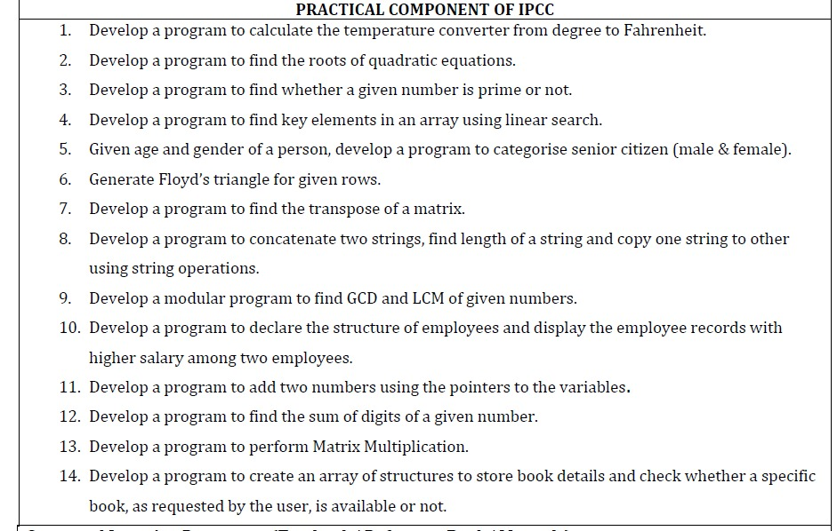

Slide 3
Develop a Program to Find the Roots of Quadratic Equations

Slide 4
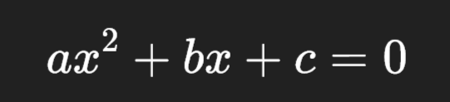
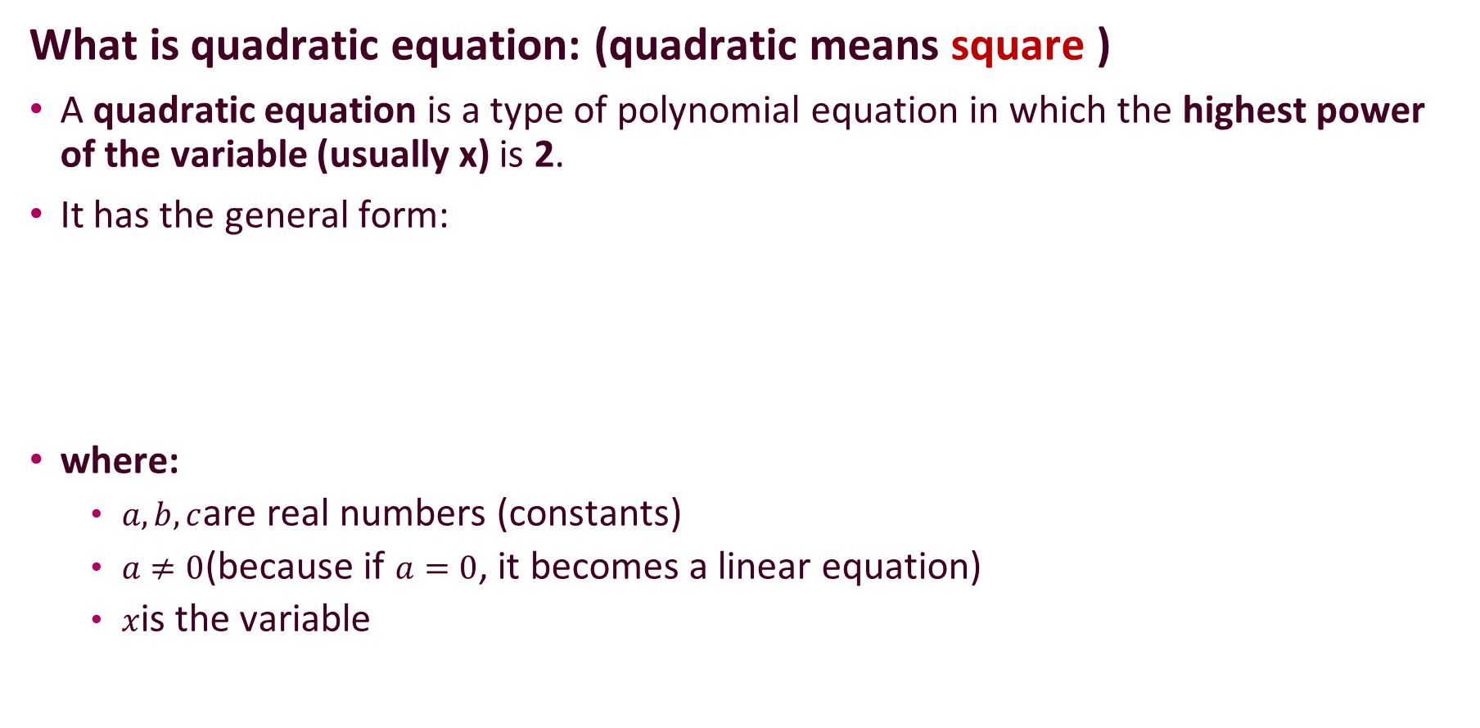
What is quadratic equation: (quadratic means square )
A quadratic equation is a type of polynomial equation in which the highest power of the variable (usually x) is 2.
It has the general form:
where:
$a,b,c$are real numbers (constants)
$a≠0$(because if $a=0$, it becomes a linear equation)
$x$is the variable

Slide 5
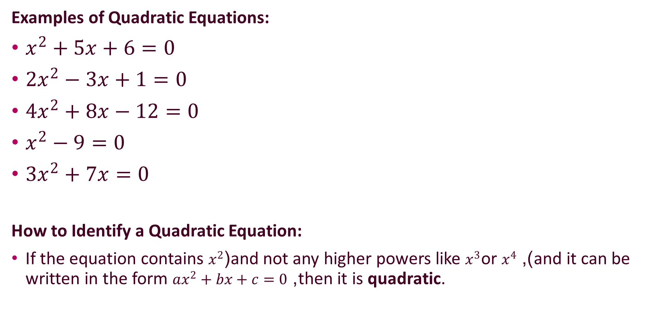
Examples of Quadratic Equations:
$x^{2}+5x+6=0$
$2x^{2}−3x+1=0$
$4x^{2}+8x−12=0$
$x^{2}−9=0$
$3x^{2}+7x=0$
How to Identify a Quadratic Equation:
If the equation contains $x^{2}$(and not any higher powers like $x^{3}$or $x^{4}$), and it can be written in the form $ax^{2}+bx+c=0$, then it is quadratic.

Slide 6
Roots of a Quadratic Equation
The roots (also called solutions or zeros) of a quadratic equation are the values of x that make the equation true — that is, the values that satisfy
In other words, if you plug a root value into the equation, the result becomes 0.

Slide 7
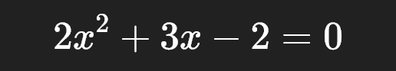
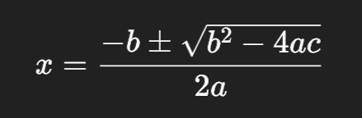
Example Equation:
Use the quadratic formula:

Slide 8
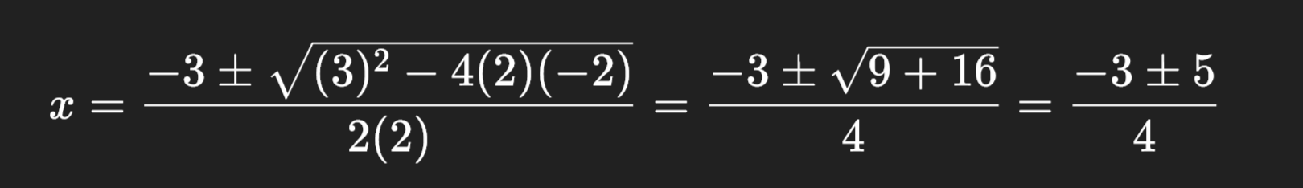
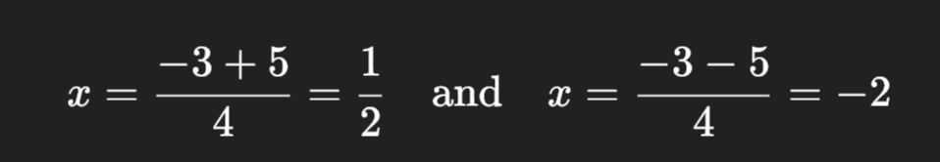

Here, $a=2,b=3,c=−2$
So,
Roots are ½ and -2.

Slide 9
Why the word “roots”?
The word “root” in mathematics comes from the idea of a foundation — just like the roots of a tree are the base or starting point of its growth.
In equations, a root is the value of x that makes the equation become zero — the point where the expression “starts” or “balances”.

Slide 10


Approach:
When a quadratic equation is like:
We calculate the discriminant:

Slide 11
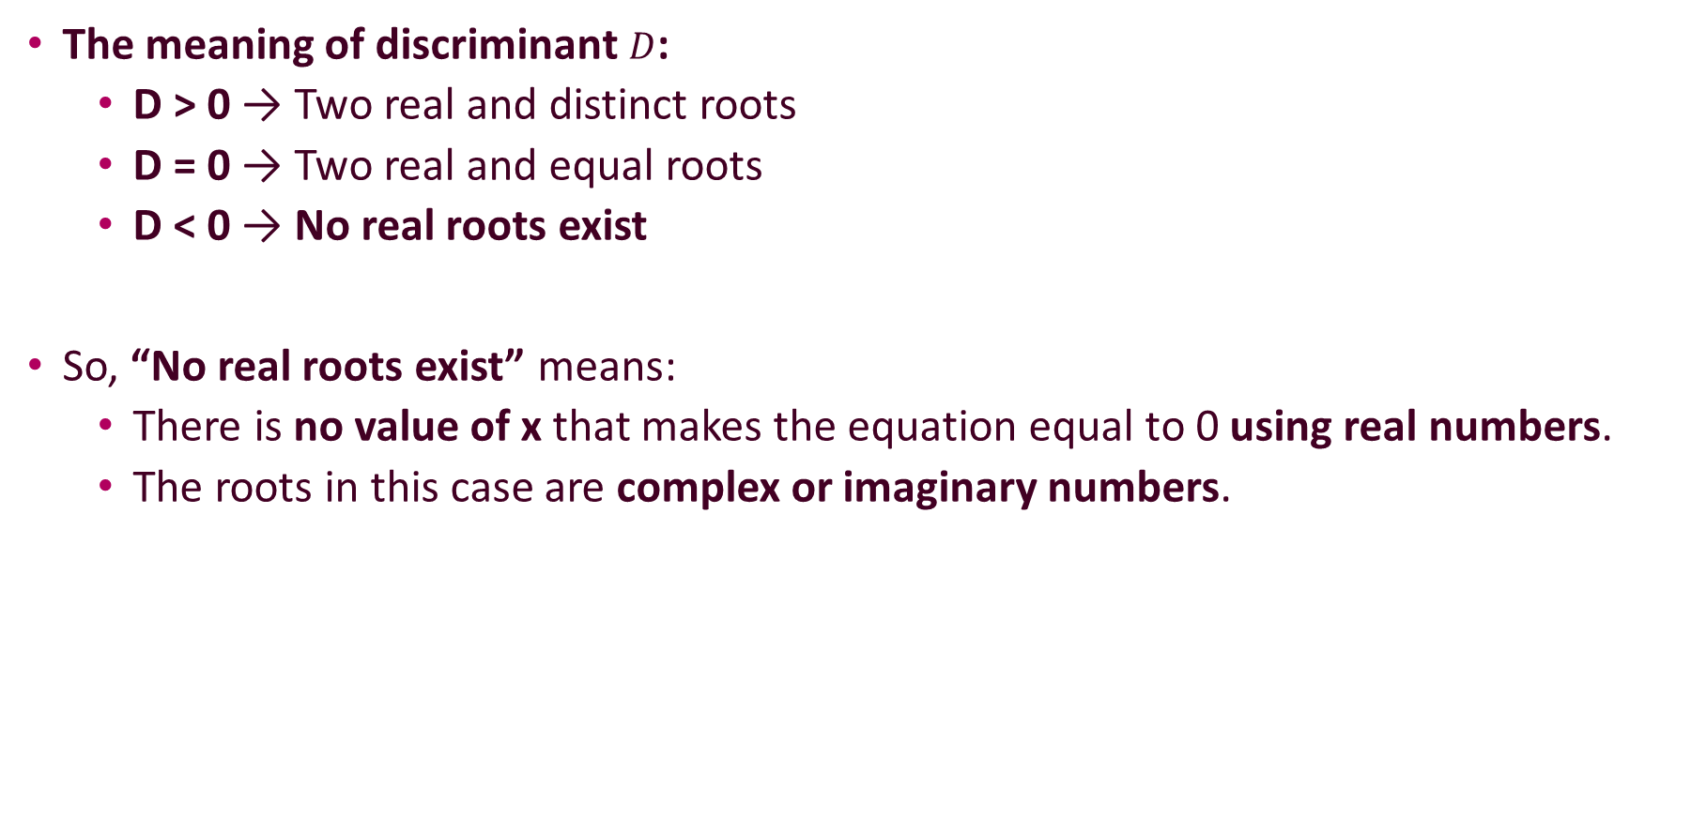
The meaning of discriminant $D$:
D > 0 → Two real and distinct roots
D = 0 → Two real and equal roots
D < 0 → No real roots exist
So, “No real roots exist” means:
There is no value of x that makes the equation equal to 0 using real numbers.
The roots in this case are complex or imaginary numbers.

Slide 12
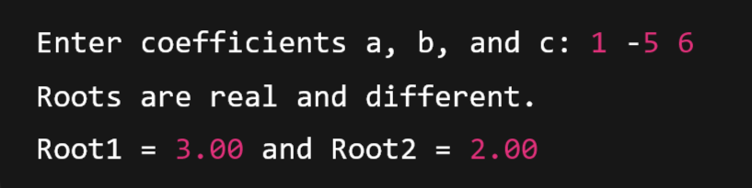
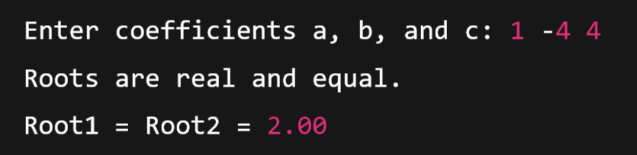

Test Case-1:
Test Case-2:
Test Case-3:

